Slide 1
EDA ON HOUSING DATASET
By - Suhana Kumari

Slide 2
Problem Statement
1.How can scaling, PCA, and fillna() techniques be used in property price prediction to handle missing data and improve the accuracy of the model?
2.To perform exploratory data analysis (EDA) on the collected data to identify key variables that influence property prices.
3. Check the outliers and handle them if required.

Slide 3
Data Exploration
There are 1460 rows and 81 columns in the data.
In our data we found missing values for some of the columns
Alley, MasVnrType these two columns have high missing value
As the most of the data is missing we can drop this columns
In our data one column name electical has also 1 missing value
As the type of data is object we applied mode as a metric

Slide 4
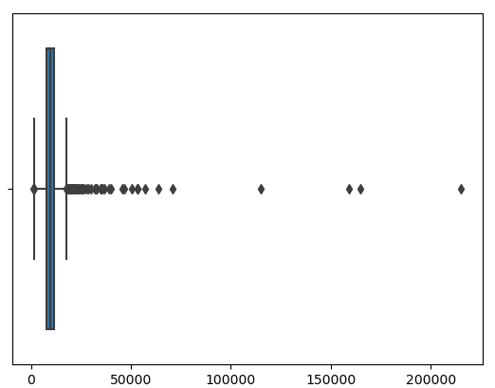
Data with outliers

Slide 5
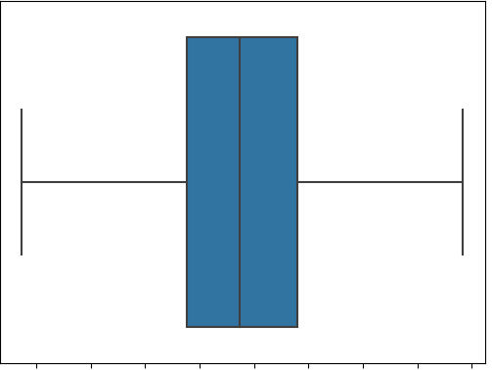
After removing outliers

Slide 6
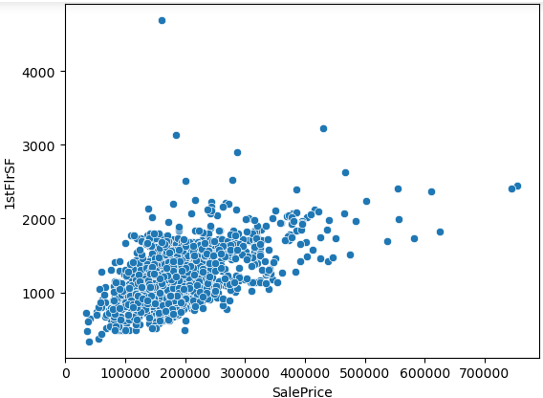
Observation : Here in Fig. we can clearly see that sale price has linear relationship with 1stFlrSF

Slide 7
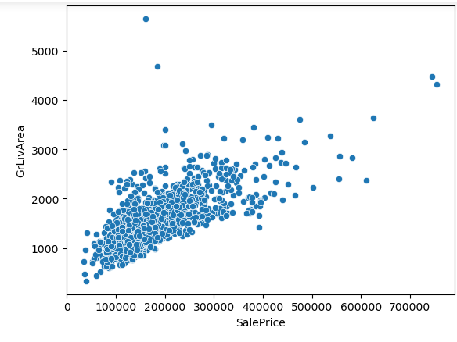
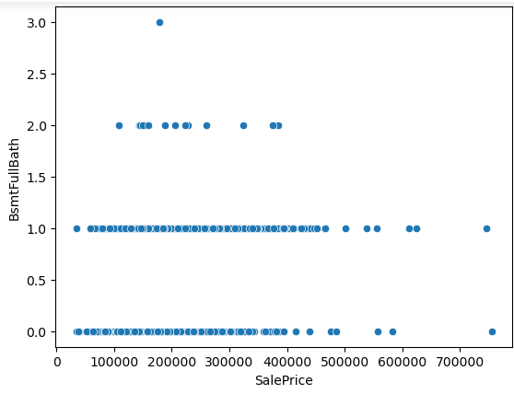
In fig 1 column has positive relationship with target and in fig 2 no relationship

Slide 8
Analysis done for each feature
Analysis like Univariate and Bivariate
For analysis used library like Matplotlib and Seaborn
How two feature correlate with each other
On categorical column performed label encoding

Slide 9
Result:
The two main feature with high co-relation with our target variable is Overall Quality and GrLivArea.
The other 6 six variables with a correlation higher than 0.5 with SalePrice are: -
1) 1stFlrSF
2) GarageCars
3) GarageArea
4) TotalBsmtSF
5) FullBath
6) TotRmsAbvGrd

Slide 10
Thank You ..!

